Slide 1
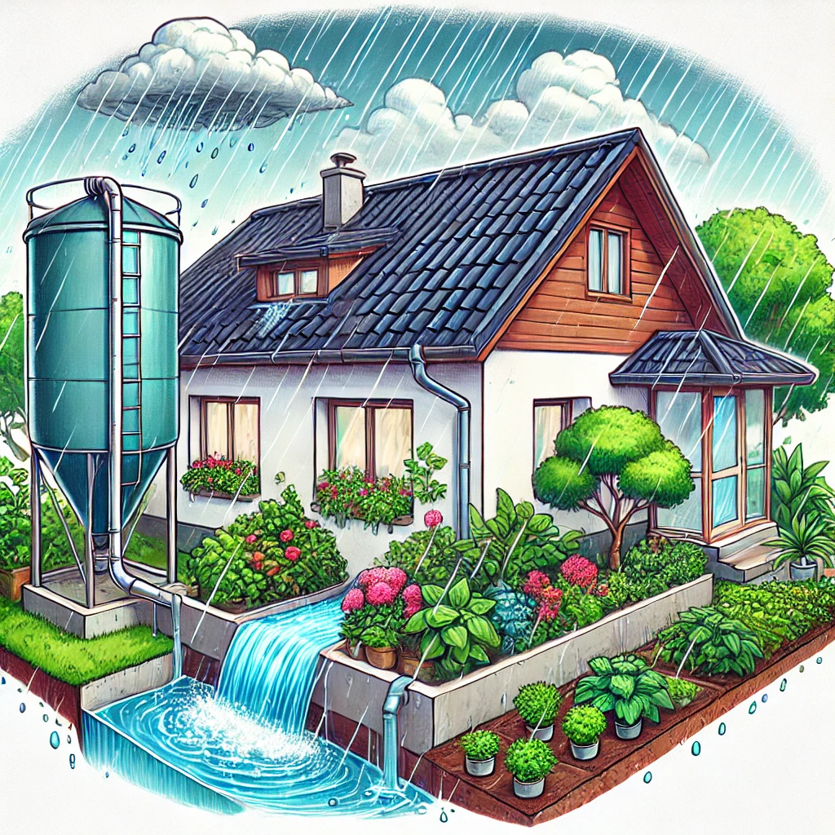
RAINWATER HARVESTING SYSTEM
DTIL GUIDANCE
Dr.Ajit Muzumdar
Prof.Pravin Chokakkar

Slide 2
Team Unbreakable Group No:16
2
Member Names
Sanjivani Mogare-2124UCSF1103
Sanika Kadam-2124UCSF1112
Harshal Navarkar-2124UCSM1015
Tejas Khalkar-2124UCSM1083
Omraje Bhalsing-2124UCSM1033
Dhanashree Nehe-2124UCSF1127

Slide 3
Agenda m Theory of prioritization m Problem statement m SCAMPER m Prototype m Journey map

Slide 4
THEORY OF PRIORITIZATION
 | 1000 | 100 | 10 | Total
Blockage of water and dirt | 0 | 600 | 0 | 600
Water Capacity of Tank | 6000 | 0 | 0 | 6000
Regular Maintainance of Tank | 2000 | 200 | 20 | 2220
Investment for the System | 3000 | 200 | 10 | 3210
Lack of Awarness of the System | 1000 | 500 | 0 | 1500
Improper Installation of the System | 2000 | 300 | 10 | 2310
Structural Damage | 0 | 300 | 30 | 330
Public acceptance | 3000 | 100 | 20 | 3120
Design | 0 | 200 | 40 | 240
Limited and low rainfall | 3000 | 100 | 20 | 3120

Slide 5
Problem Statement
5
- In urban and rural areas, rainwater harvesting systems are becoming increasingly important as a sustainable way to conserve water, reduce dependency on municipal water supplies, and mitigate the effects of water scarcity. However, one of the biggest challenges faced by these systems is proper management of the tank's water capacity and How can we avoid water by getting contaminated?

Slide 6
SCAMPER
S-Substitute
C-Combine
A-Adopt
M-Modify
P-Put to another use
E-Eleminate
R-Reverse
SCAMPER as a teaching strategy helps the students to analyze the knowledge in its creative form and helps the teacher to make teaching creative and interesting.

Slide 7
Detailed about SCAMPER
SUBSTITUTE- We can use more sustainable materials for rainwater harvesting components (e.g., biodegradable filters, recycled plastic pipes).
COMBINE- Combine individual household systems with community-based storage facilities, increasing the scale of rainwater harvesting.
ADOPT- Use green roofs that not only collect rainwater but also help with insulation and urban heat island reduction.
MODIFY- Increase the storage capacity of rainwater harvesting systems in urban areas to meet growing water demands.
PUT TO ANOTHER USE- Use rainwater for non-drinking purposes like cleaning, cooling systems, or industrial uses.
ELIMINATE- Simplify the cleaning, maintenance, and monitoring processes for rainwater harvesting systems to reduce long-term costs and effort.
REVERSE- Simplify the cleaning, maintenance, and monitoring processes for rainwater harvesting systems to reduce long-term costs and effort.

Slide 8
SELECTED TECHNIQUES FROM SCAMPER -ADOPT- Use green roofs that not only collect rainwater but also help with insulation and urban heat island reduction. -MODIFY- Increase the storage capacity of rainwater harvesting systems in urban areas to meet growing water demands. -PUT TO ANOTHER USE- Use rainwater for non-drinking purposes like cleaning, cooling systems, or industrial uses.

Slide 9
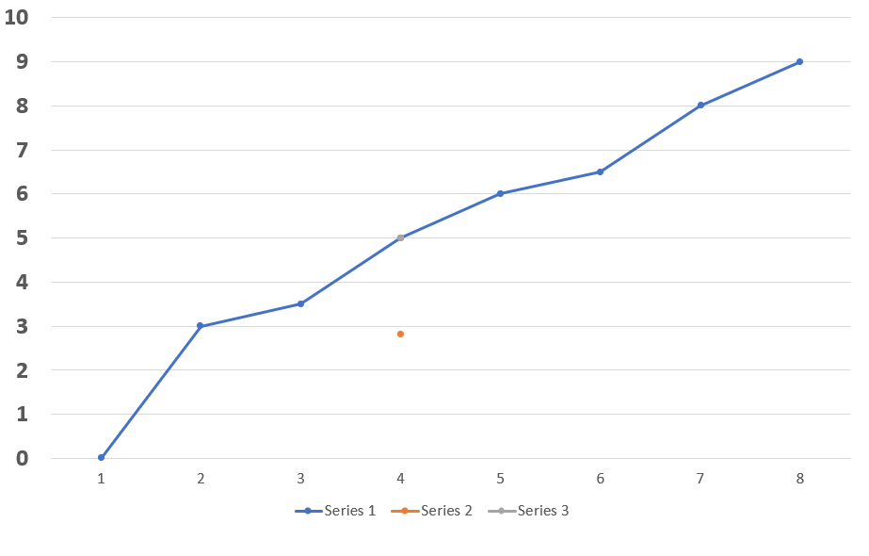
JOURNEYMAP-1 Farmer
EVENT 1-Awarness and exploration of the App.
EVENT 2-Evaluation and Research of App.
EVENT 3-Decision and Making and Purchase.
EVENT 4-Installation and Setup.
EVENT 5-Initial Use and Monitoring.
EVENT 6-Regular Use and Optimization.
EVENT 7-Maintainace and Trouble shooting.
EVENT 8-Long term Usage of App.

Slide 10
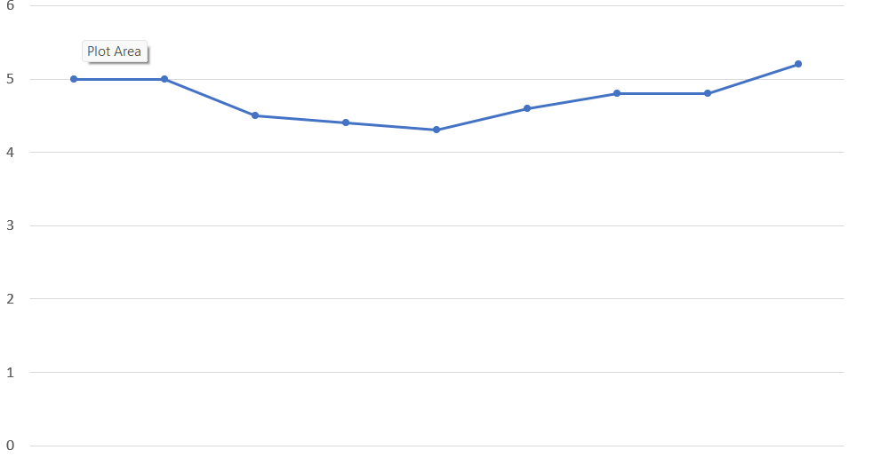
JOURNEYMAP – urban people
EVENT 1-Installation of the App.
EVENT 2- Account Creation .
EVENT 3- Installation of Rainwater harvesting App.
EVENT 4-Learning the dashboard and Feature.
EVENT 5-Monitoring Water Collection.
EVENT 6-Alerts and Notification.
EVENT 7-Maintanence and Troubleshooting.
EVENT 8-Advance Feature.
EVENT 9- System Optimization.

Slide 11
Thank You!

